Slide 1

Park Elsewhere
Mehdi, Rebecca, Ali, Kishan and Asaas

Slide 2
What is our project?
Show you care, park elsewhere.
Brief - Digital Labs
*Project Manager, Client advocate, User advocate, Tech lead, Developer
Brief (Alice, pram, reports parking, sticks sticker)
Jethro (sticker printer, stickers, desktop app)
Bob (van driver, poor parking, apologies)
Mobile & desktop application
Allows user to mark poor parking of individuals.
I have personally experience bad parking, and this project offers an ingenious solution. I was particularly interested in working with QR technology and developing a mobile application.

Slide 3
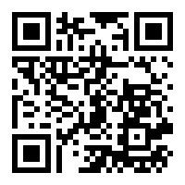
What is our interpretation of the brief?
Reporter Car Owner
Opens app
Scans stickers QR code
Scans car number plate
Places sticker
Car owner scans qr code
Can apologise or ignore
If apology is chosen, notification sent to the person who places sticker
Notes:
TWO SIDES OF OUR PROJECT
REPORTER
CAR OWNER
Reporter
Take out a sticker
Opens the app
Scan the qr code on sticker
Scan the number plate
Place the sticker
Walk away
CAR OWNER
Find the sticker on their car
Scans the qr code
Gets taken to a website
Given option to apologise or ignore
If apologise notification sent

Slide 4
Requirement Analysis
Client (Digital labs) requires final product to be 2 applications that are associated with specific users i.e. -
Jethro - Desktop application, which then links with
Alice/Bob - Park elsewhere mobile application
Stakeholders
Digital Labs
General Public Who Experience Bad Parking
Parking Attendants
Notes:
Digital Labs - CLIENT
Application associated with 2 users
Jethro desktop application
Alice and bob park elsewhere app
Stakeholders
Digital labs
Parking attendants
General public - bad parking

Slide 5
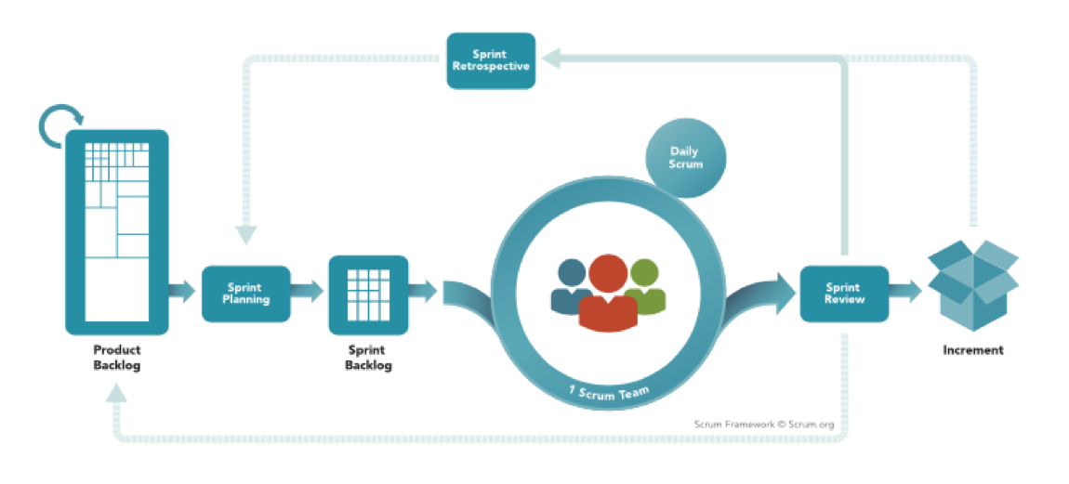
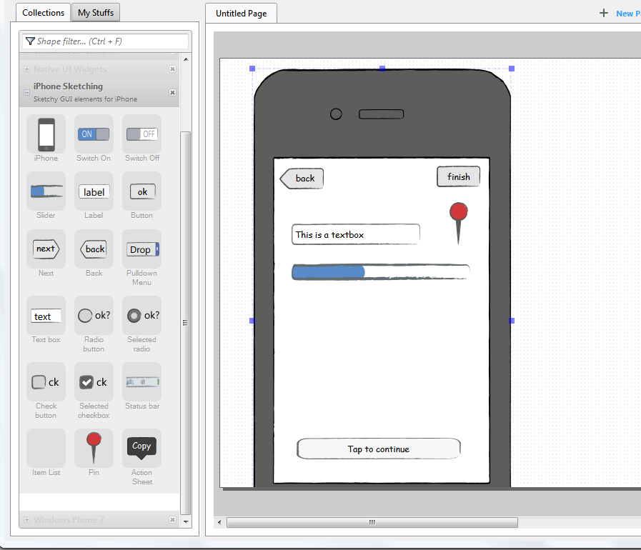
What are we going to do to solve the problem and when?
Project Management Methodology chosen:
We have chosen Scrum, aided by Trello.
Design Process:
List of features on Trello
Using Github for design work
Wireframing:
Used to lay out content on a page
We will use Evolus Pencil

Slide 6
Backlog
11/26/2018 | 12/3/2018 | 12/10/2018 | 12/17/2018 | 12/24/2018 | 12/31/2018 | 1/7/2019 | 1/14/2019 | 1/21/2019 | 1/28/2019 | 2/4/2019 | 2/11/2019 | 2/18/2019 | 2/25/2019 | 3/4/2019 | 3/11/2019 | 3/18/2019 | 3/25/2019
Technical Investigation
Implementation
Release
All features expected to be complete by 25th February 2019
User stories used to identify features
Features allocation:
Mobile App - Mehdi & Ali
SPWA for Bob - Asaas
SPWA for Jethro - Rebecca
API - Kishan

Slide 7
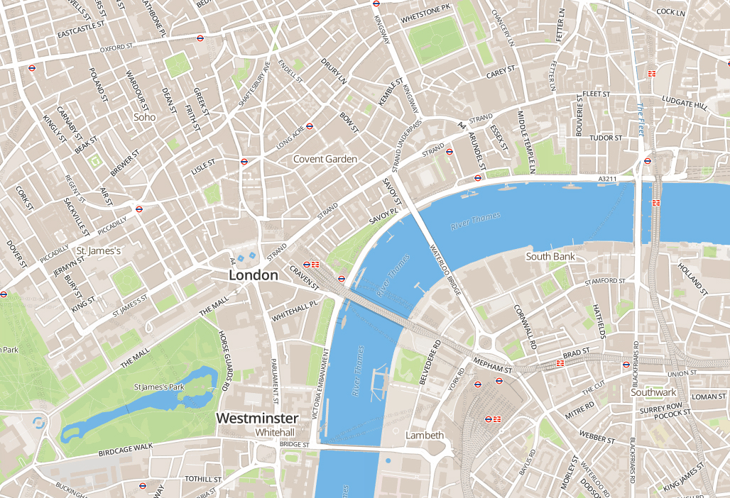

Potential Technologies
UUID
Used as private key for each sticker in the database
MapBox
Allows user to search for reports using the online map.
Ionnic V1/Cordova
Used to build mobile applications.
AngularJS
JavaScript front-end framework used to create Single Page Web App (SPWA)

Slide 8
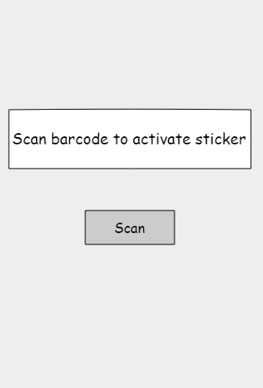
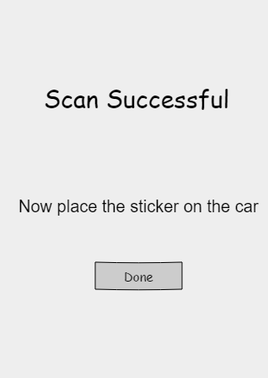
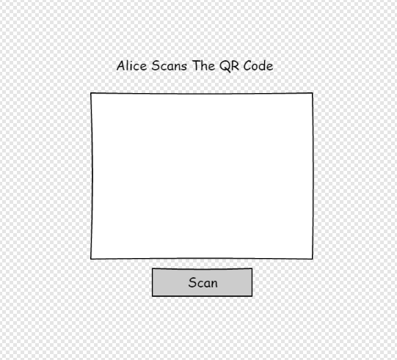
What will we need to learn to put our plans into action and how?
Learning Resources
Using and learning from online resources for our project.
Updates
We are planned to use our first plan designs we did.
Use Trello and GitHub to regularly update.
Updates towards our client (Digital Labs).
End User
Taken into action so there's no difficulties using our service.
Skills Required
Communication, Technical, Team-work skills etc.
Computing Experience/Knowledge to help towards the project.

Slide 9
What could go wrong?
Ineffective Quality Controls
Quality is a simple system of checks and balances to ensure you are delivering what the client asked for in the first place.
Most projects have a system for correcting problems but this is not the same as a system of corrective action. Ineffective quality controls are definitely one of the causes of project failures.
Poor Planning
Poor planning means that the schedule that the team members are supposed to follow is not set out.
The members will have no clear picture of what is expected of them as they work on the projects.
There will be no deadlines to meet hence creating a lazy atmosphere among the team members.
Inadequate Resources
Projects are frequently impacted by risks, assumptions about resource usage, or plain old surprises
The traditional solution is to ass safety time or buffers to tasks to allow for schedule slippage and unplanned events
Poor Communication
Lack of communication causes unmet expectations. Teams miss deadlines, and people on a project do not seem to know what their roles are.
When group members have trouble figuring out what their priorities should be, they often choose the wrong thing and end up disappointing their client.
Without clearly communicated expectations and priorities, it is impossible to know where to start and how to complete a project efficiently.

